Slide 1
Nordic-Baltic mobility programme for Culture

Slide 2
The Nordic-Baltic mobility programme for Culture: background
Established in 2009
The Nordic and Baltic Ministers for Culture have agreed to promote mobility as an important instrument to strengthen the conditions for cultural and artistic cooperation in the Nordic-Baltic region
Decision of the funding is decided by the Nordic and Baltic Ministers for Culture
Funded by the participating countries (Estonia, Latvia, Lithuania, Finland, Sweden, Denmark, Norway, Iceland, Greenland, Faroe Islands, Åland)

Slide 3
The Nordic-Baltic mobility programme for Culture: purpose
The main focus of the programme is to support mobility for artists and professionals and to enhance artistic and cultural collaboration in the region.
For this purpose, the programme has three modules:
Mobility funding for individuals and small groups
Funding for short-term and long-term networks
Funding for artist residency centres

Slide 4
mobility programme mobility funding
For professional artists and cultural operators living in the Nordic and Baltic countries
Professional visits to another Nordic or Baltic country from 1-10 days
Covers travel and accommodation (fixed amount)
Travels should promote cultural exchange within the Nordic and Baltic region
New initiatives are prioritized

Slide 5
mobility programme mobility funding
For individuals and small groups up to 6 people
Only professionals
Not for students, nor organisations
Residents of the Nordic and Baltic countries

Slide 6
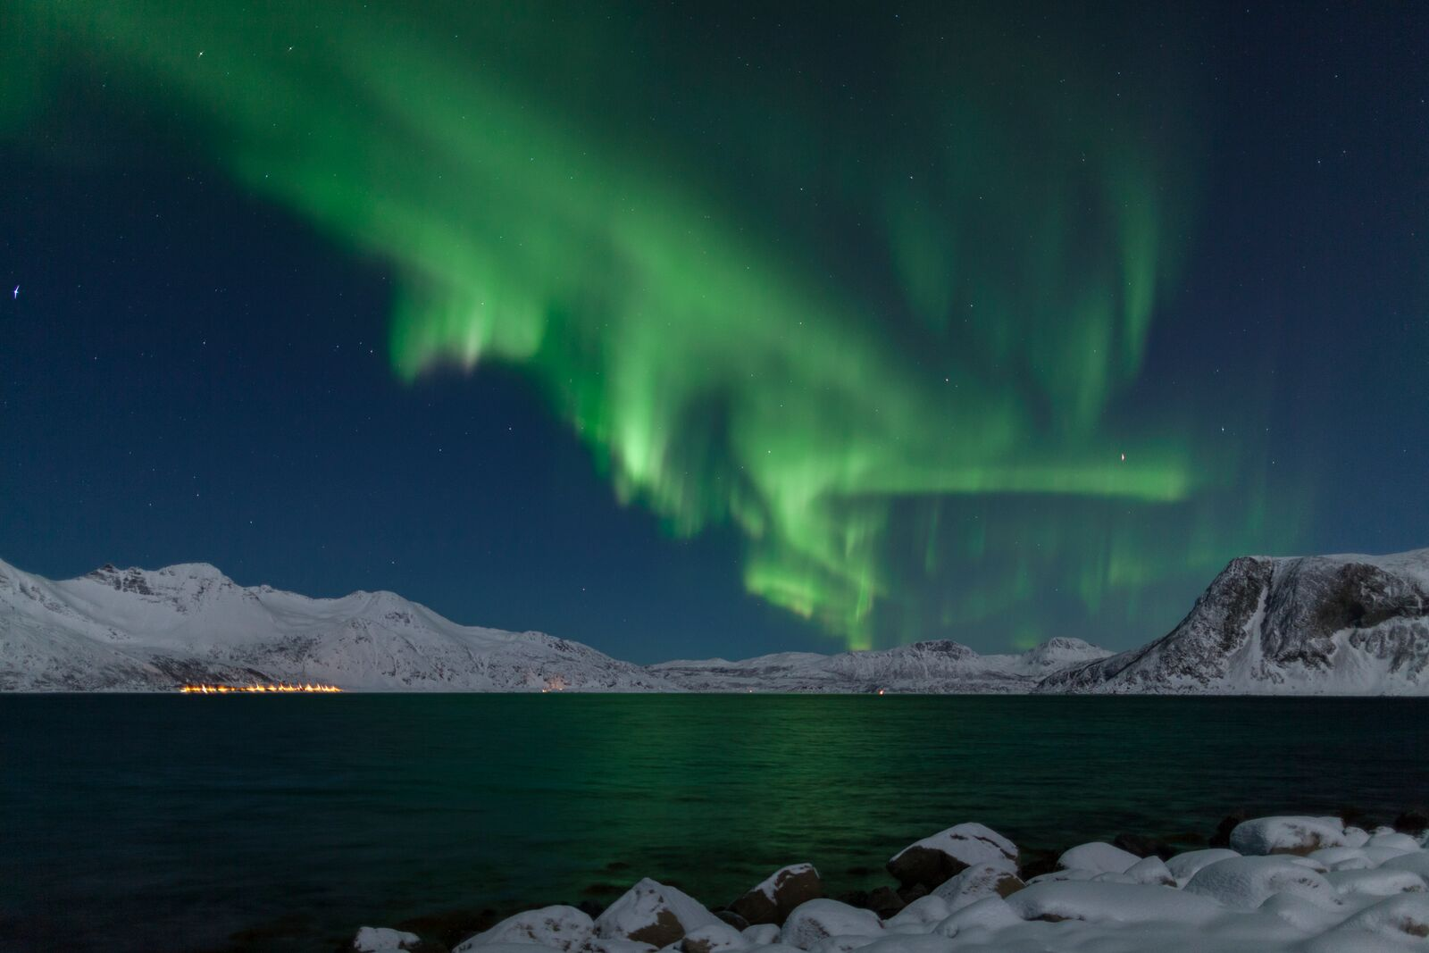
PROJECT EXAMPLE – MOBILITY FUNDING
“Nordic Light” a multimedia symphony by Ēriks Ešenvalds
“Northern Lights Expedition”
Who? Latvian composer Ēriks Ešenvalds
What? A travel to Tromsø to visit folklorist Hauan Marit Anne and Prof. Ola Graff, Tromsø Museum, a representative of Arctic Philharmonic Orchestra and Kjetil Skogli, a master in Aurora Borealis’ photography for a multimedia project “Northern Lights: folklore, science and video in music constellations”.
Photo: Kjetil Skogli

Slide 7
mobility funding application deadlines 2019
January 3 – February 4
March 4 – April 4
July 23 – August 22
September 19 – October 21

Slide 8
mobility programme network funding
Short-term network funding up to 1 year
max. amount 20 000 EUR (max. total 70 %)
Long-term network funding up to 3 years
max. amount 100 000 EUR (max. total 50 %)

Slide 9
mobility programme network funding
Partners from at least 3 Nordic/Baltic countries
Co-operation with other countries can compliment
Intended for sharing knowledge, ideas, experience and develop partnerships between actors within the field of arts and culture
Network activities may include a series of meetings, conferences, workshops, staff exchanges and joint courses etc

Slide 10
Clear objectives and schedule The network should clearly define its overall objectives and create a set schedule. In this context it is advisable for the objectives and the ideas behind them to be innovative.
Quality and cooperation The networks should be started to plan artistic initiatives and/or to develop cooperation and new ways of working together. The network should create new contacts within its area of work and have contact with other networks. New networks and cooperation with cultural diversity or between several different types of artistic and cultural bodies are prioritised in the assessment.

Slide 11
Information work The network should strive to make its work accessible to others and disseminate information about its results in a transparent manner.
The Nordic-Baltic dimension
promotes and increases contacts, communication and activities between the Nordic and/or Baltic countries
strengthens the Nordic-Baltic presence in cultural life in the Nordic region and Baltic states
strengthens understanding of similarities and differences between the Nordic and Baltic countries
increases knowledge of the Nordic and Baltic artists and their work

Slide 12
PROJECT EXAMPLE – NETWORK FUNDING
“Network of the Writers' Unions of the Baltic Countries ”
Who? Writers' Union of Latvia (LV)
What? To set up a regular exchange between the writers' unions of the three Baltic countries in order to strengthen mutual cooperation within the Baltic region in the field of literature, fostering interest about each others country's literature, encouraging the exchange and mobility of the staff and authors; fostering translations, education of new translators, sharing experience on literary representation of authors, management, and issues of cultural policy.

Slide 13
network funding application deadlines 2019
January 16 – February 18
August 26 – September 26

Slide 14
mobility programme artist residencies
Support for artist residency centres (up to 3 years), max amount EUR 50 000
Travel expenses, daily allowance and other direct costs which arise in connection with the residency stay of the artist(s)
15 % can be administrative expenses
Not for individual artists
Residencies choose the visiting artists
The application should be for at least 2 artists
Residencies should facilitate exchange between the artist and the local community

Slide 15
PROJECT EXAMPLE – ARTIST RESIDENCIES
”
“International Writers’ and Translators’ House”
The International Writers’ and Translators’ House is a multifunctional international writer’s and translator’s centre, which promotes the development of literature, encourages cross-cultural dialogue and introduces the Latvian literary process to international circulation. The main purpose of the residency is to promote literary co-operation within Nordic - Baltic region by supporting more authors and translators from the region, giving them common space and time for creative writing.

Slide 16
artist residencies application deadline 2019
January 18 – February 7

Slide 17
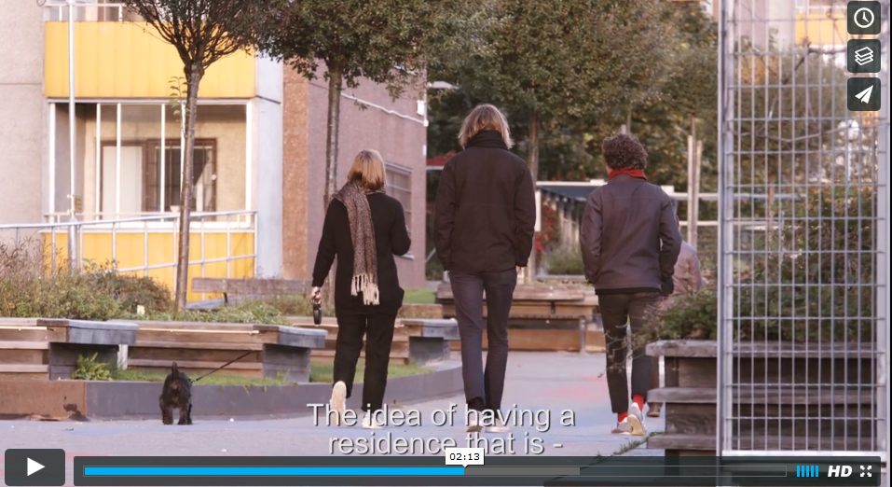

Slide 18
The Nordic-Baltic mobility programme for Culture: key figures
Total granted amount in 2017: 1 759 372 €
Applications in total 1060 of which 30 % were granted
 | Applications | Approved | Applied | Granted
Mobility | 865 | 278 (32 %) | € 2 077 420 | € 573 945 (32 %)
Network | 132 | 27 (20 %) | € 3 729 327 | € 863 591 (24 %)
Residencies | 63 | 15 (24 %) | € 1 759 623 | € 321 836 (18 %)

Slide 19
Supported projects from Latvia
 | 2009 | 2010 | 2011 | 2012 | 2013 | 2014 | 2015 | 2016 | 2017
Mobility | € 51 308 36 projects | € 35 500 24 projects | € 34 397 22 projects | € 75 300 39 projects | € 48 200 34 projects | € 45 540 25 projects | € 46 100 20 projects | € 24 510 11 projects | € 33 220 21 project
Network Short term | € 88 792 5 projects | € 59 560 5 projects | € 86 210 7 projects | € 39 500 3 projects | € 29 565 3 projects | € 65 000 6 projects | € 59 920 3 projects | € 37 870 2 projects | € 86 615 3 projects
Network Long term | € 37 772 1 project | € 140 000 1 project | 0 | € 60 000 1 project | 0 | € 68 407 1 project | € 110 870 2 projects | 0 | 0
Artist Residencies | € 23 000 2 projects | € 6 500 1 project | No call in 2011 | € 14 680 2 projects | No call in 2013 | No call in 2014 | € 30 000 2 projects | € 10 000 1 project | € 42 000 2 projects
Total | € 200 872 44 projects | € 209 560 31 project | € 120 607 29 projects | € 189 480 45 projects | € 77 765 37 projects | € 178 947 32 projects | € 246 890 27 projects | € 72 380 14 projects | € 161 835 26 projects

Slide 20
Tips to remember!
Get acquainted with the programme’s criteria
Describe the project and budget precisely: who, what, when, why
Submit the application in good time
Deadline is 15:59, Finnish time
Assessment by an external group of experts
Results announced 2 months after the deadline
Granted projects may begin 2 months after the deadline
Last 15% are paid after reporting

Slide 21
Nordic Culture Point
program@nordiskkulturkontakt.org
www.nordiskkulturkontakt.org
Order the newsletter from www.nordiskkulturkontakt.org or by e-mail
#kulturkontaktnord

Slide 22
Nordic Council of Ministers’ Office in Latvia
Culture Adviser Ginta Tropa
E-mail: ginta@norden.lv
Phone: +371 26362558
www.norden.lv

